Slide 1
“Installing” or using Charts.js

Slide 2
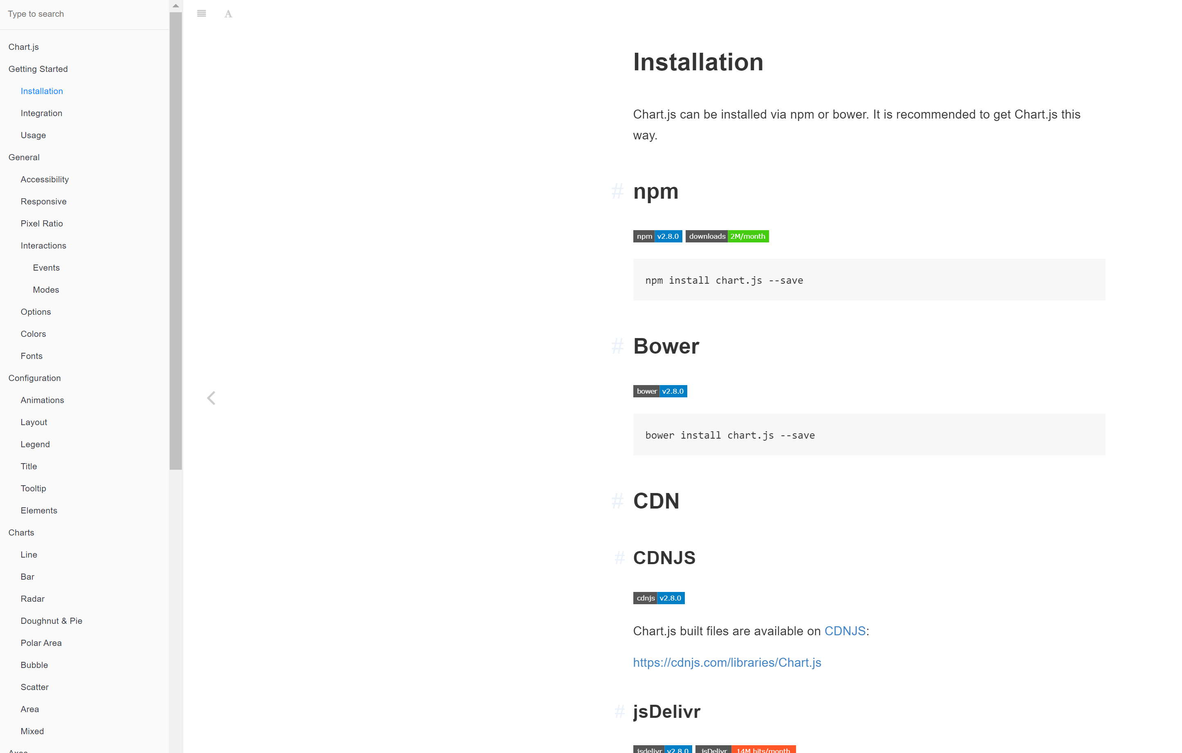
If you have an npm or Bower server account, then installation is easy. It’s like pip install for javascript
If you don’t have an account
Then typing this into your
Command line will do nothing
Use CDNJS or JsDelivr

Slide 3
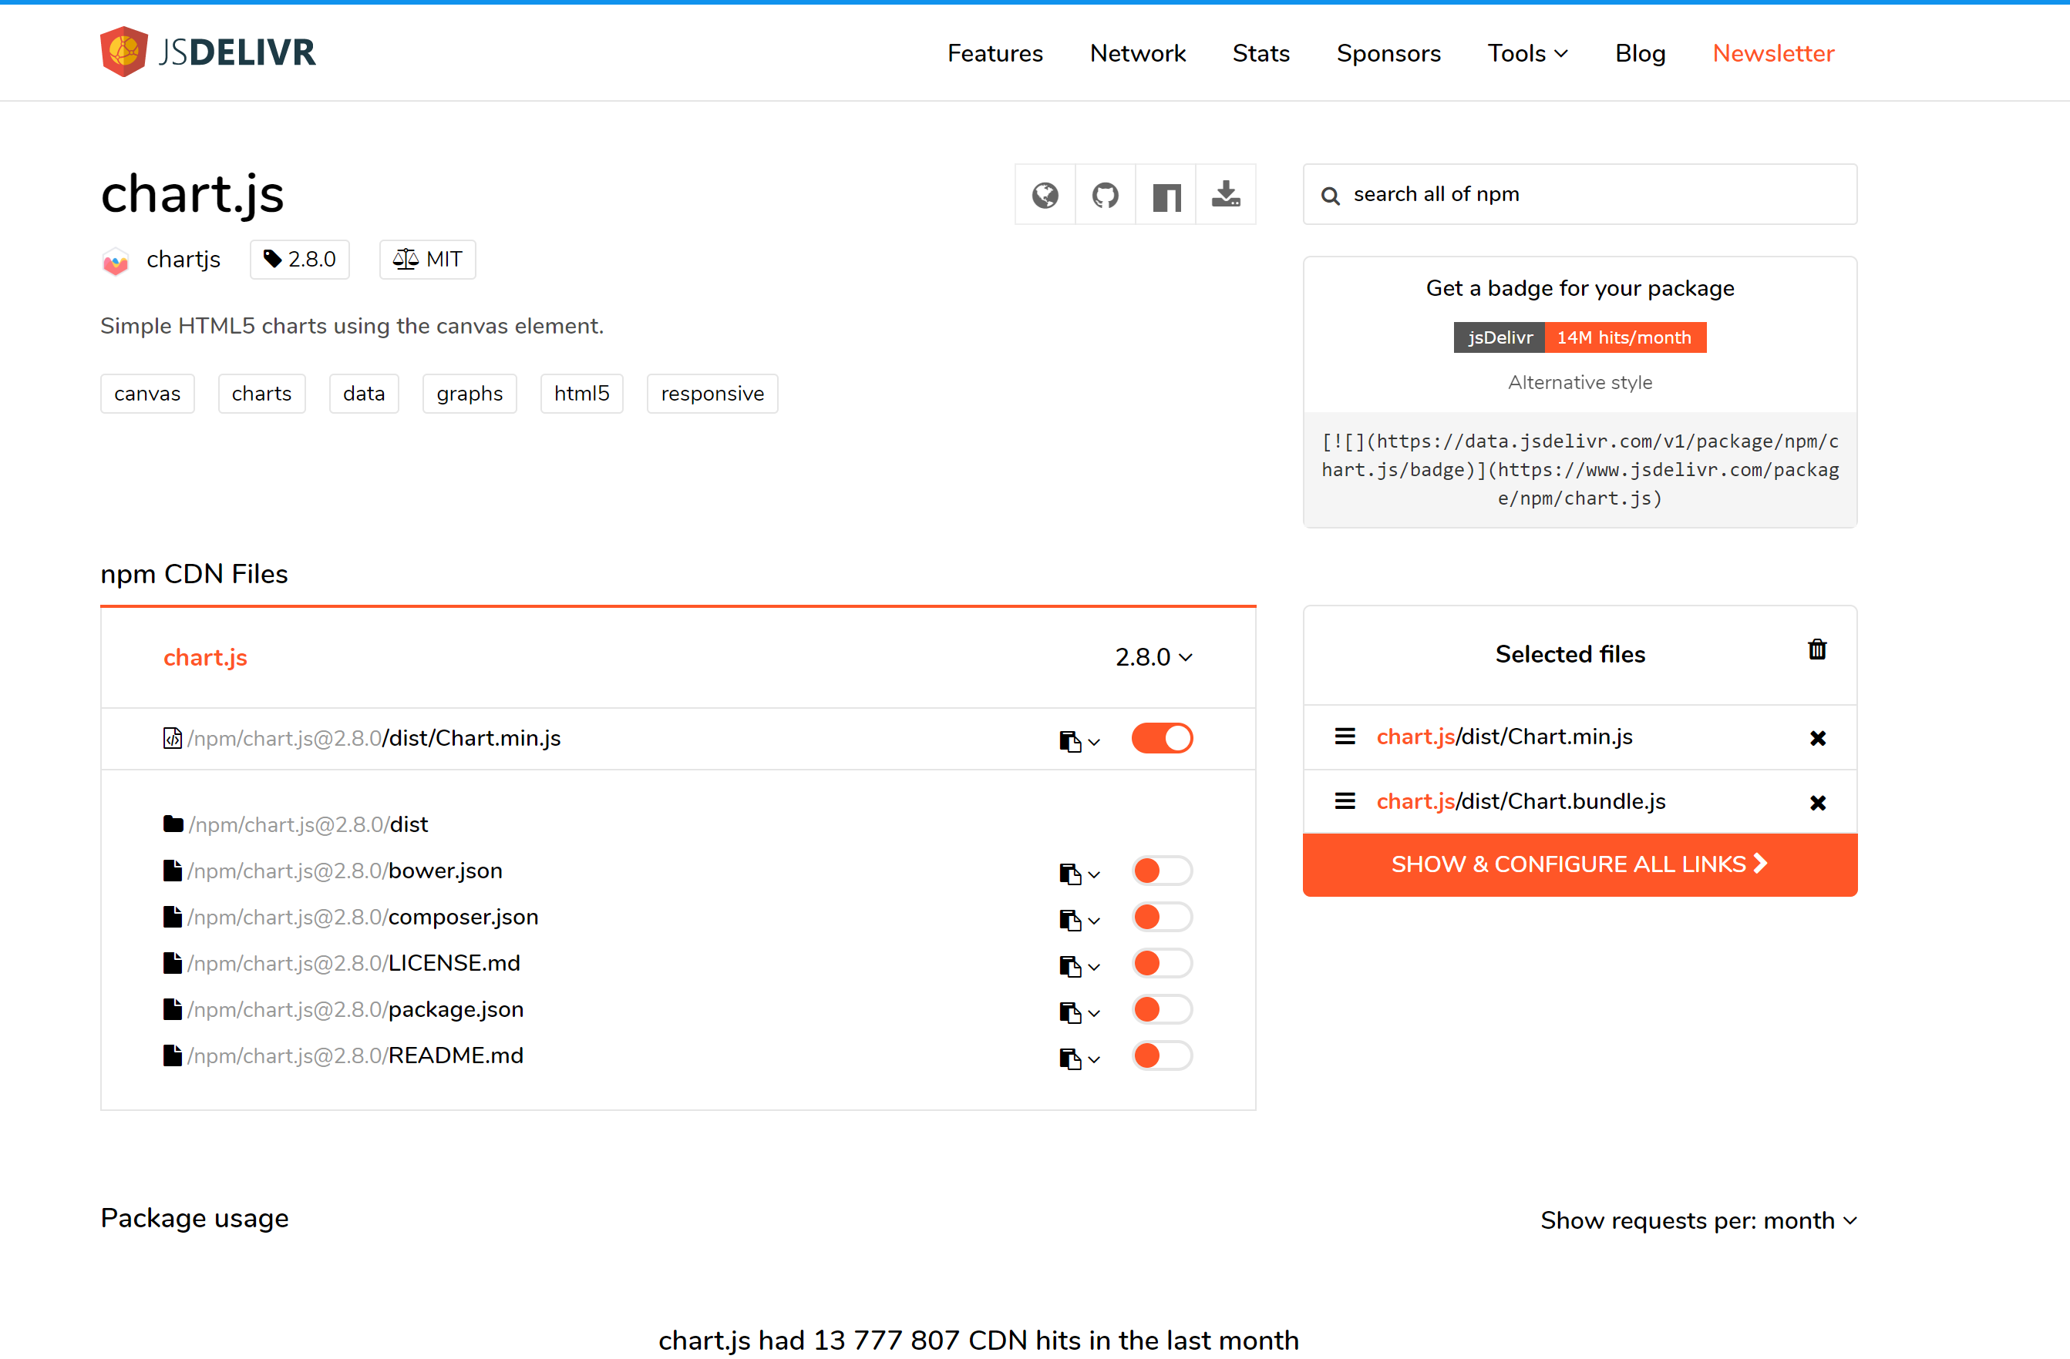
Select Chart.min.js if it isn’t selected already
Then click the orange box (“Show and Configure
All links

Slide 4
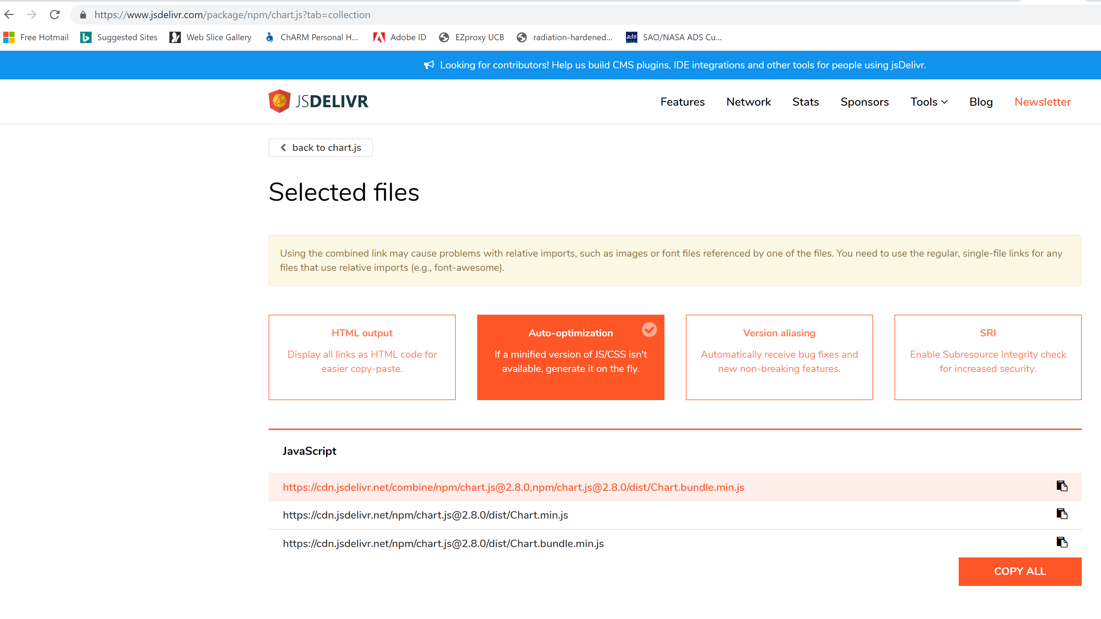
Copy the
Most recent
https reference
To the clipboard
By clicking on the small clipboard icon

Slide 5
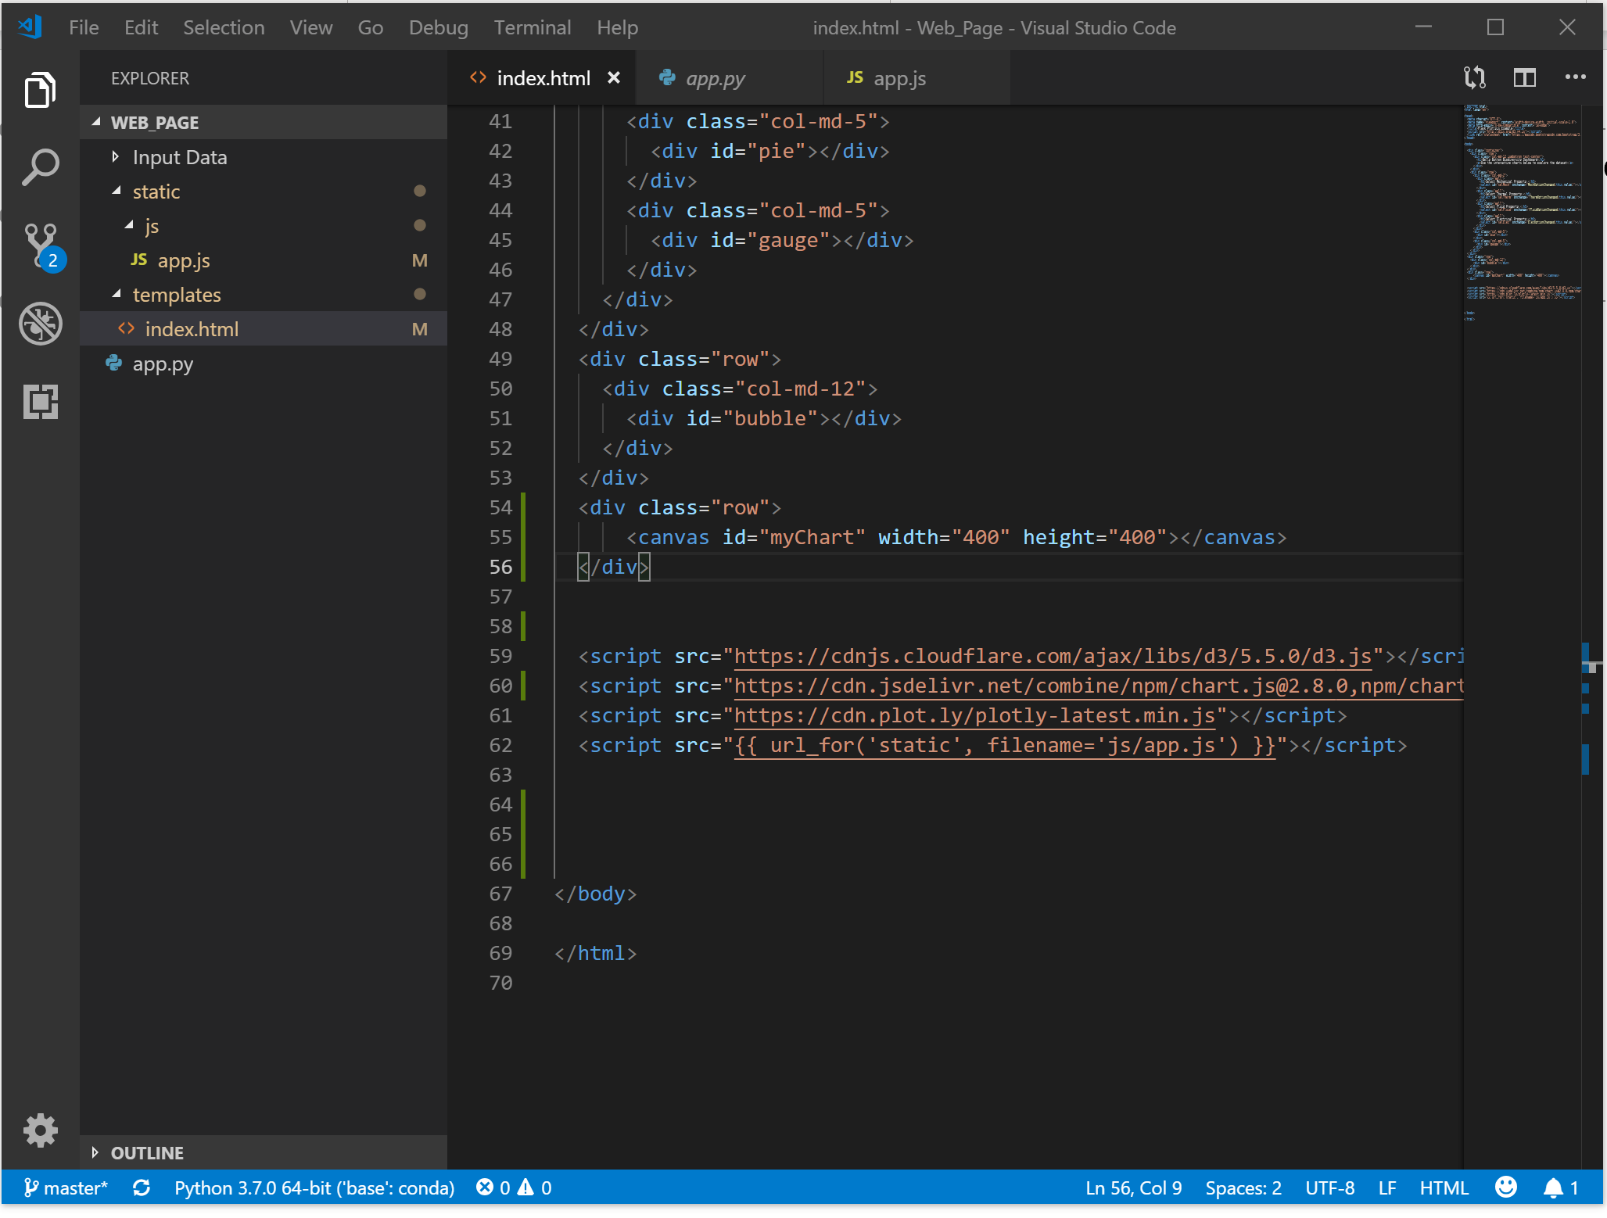
Go to your index.html file, to the bottom of the file, or wherever it is you have your scripts to call different libraries
Create a script tag and then paste in the website you just clipped (see line 60)
For testing, you can temporarily drop in
sample code from the chart.js website
Into the index.html, just to check there are
No errors.
Line 53-56 is the container (<div /div>
And the code needed for chart.js
(line 55). Line 55 came from the
Sample code on the chart.js website
Here you don’t see the rest of the code
Because it was moved to app.js after testing
The code inside the index.html showed
It worked.

Slide 6
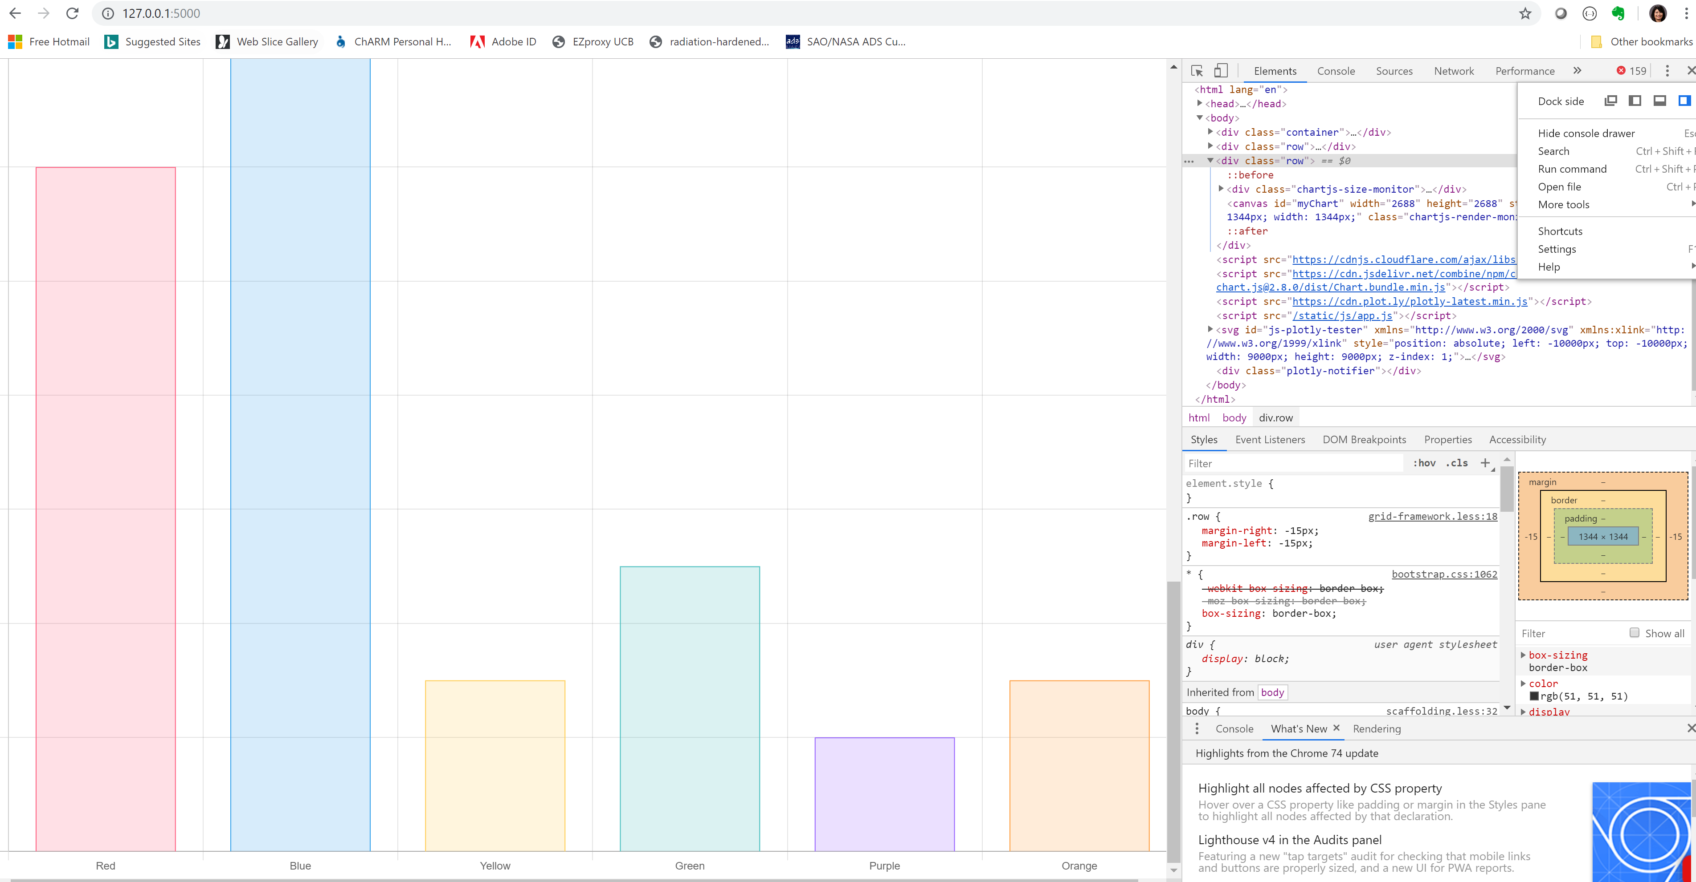
Running index.html (open in default browser). The chart.js sample code was put in the bottom of the index.html
And also the bottom of the app.js, so there is shows below the other graphics (for now),
Initially there was 1 error in Console. Because couldn’t find the app.js file, because we ran the code from index.html
So, you need to run the code, by moving to the directory with app.py, then at the command line: python app.py

Slide 7
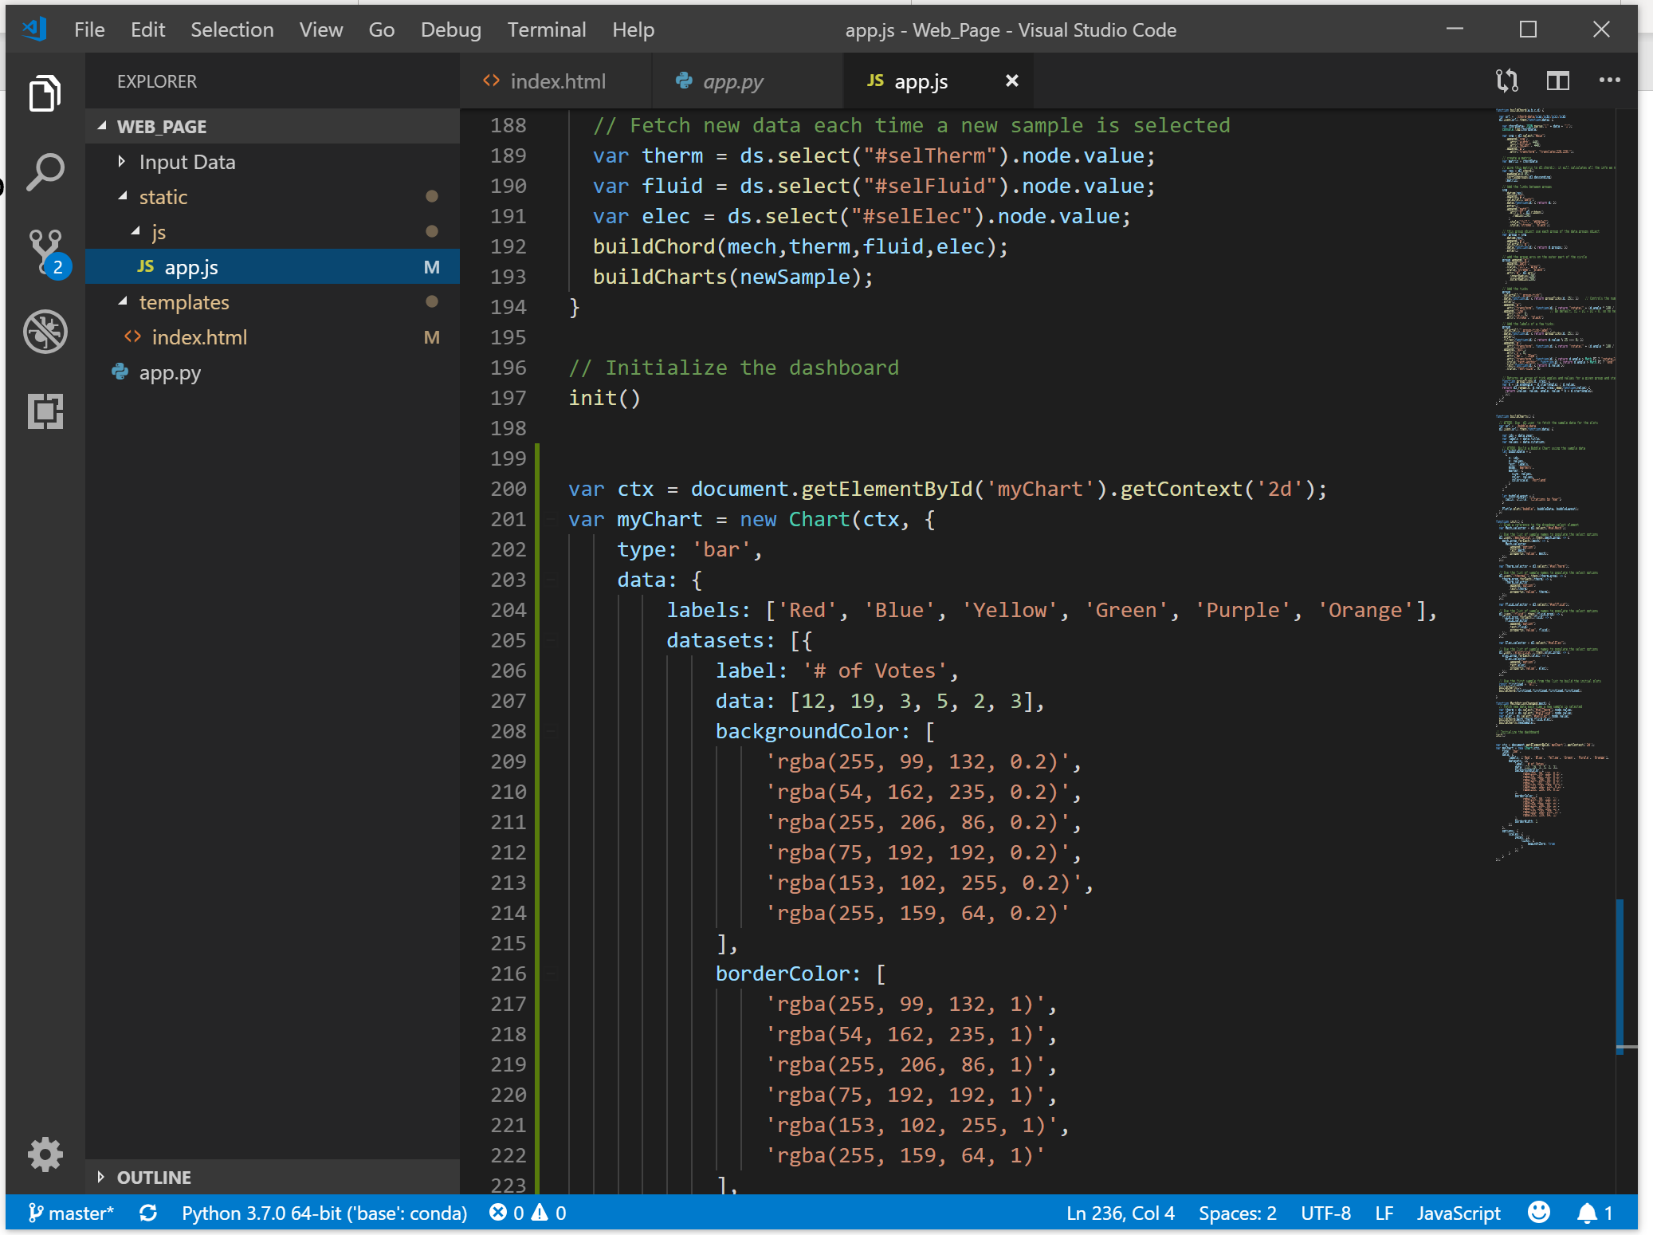
Checking app.js, you can add the sample code for the bar chart at the bottom of the file
Added chart.js sample code
From line 200-236
This is where the data will
Be passed in
(need to modify label, data
Etc)
Run the code by using the
Command line, python app.py
While in the same directory

Slide 8
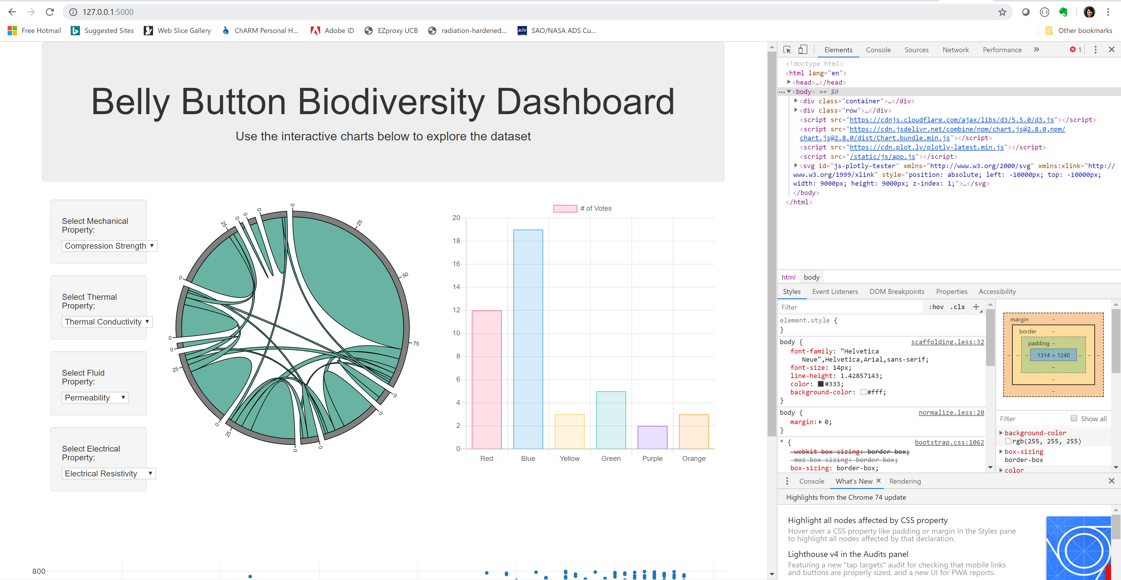
Moved the bar chart to where the gauge ued to be

